Slide 1
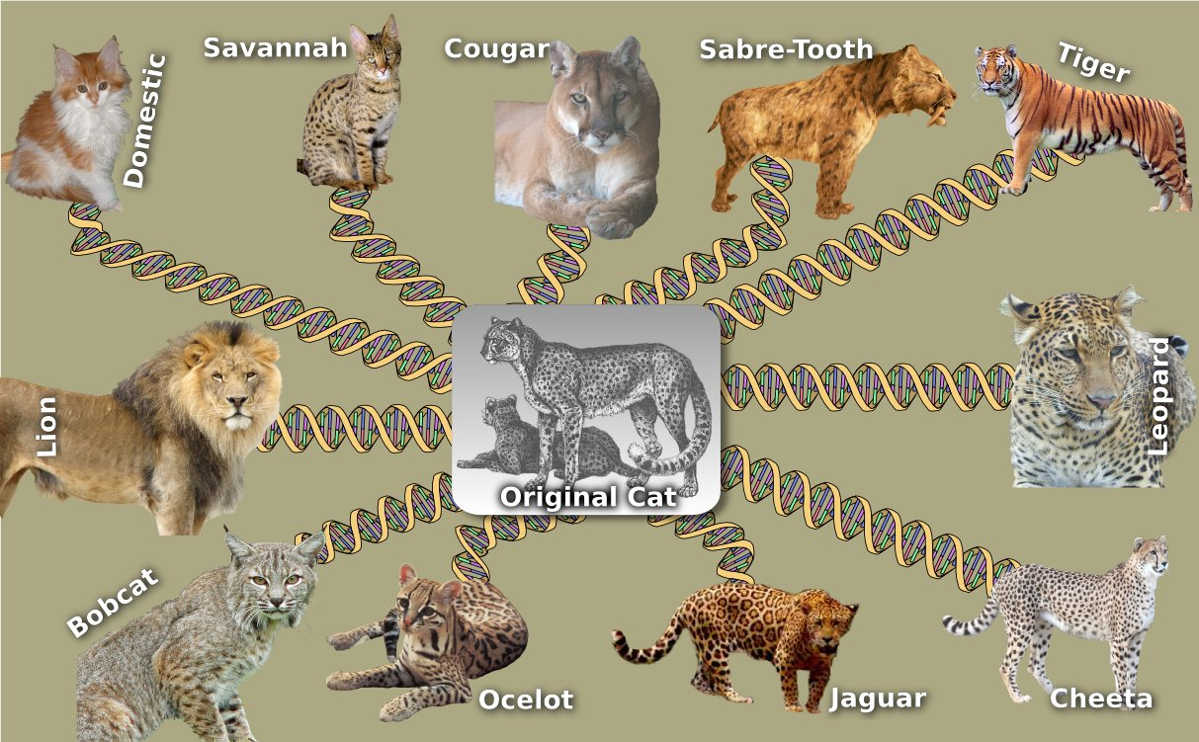
Maximum Likelihood Estimation
Lecture – 12
Department of CSE, DIU

Slide 2
CONTENTS
Maximum Likelihood Estimation
Calculate Maximum Likelihood of a Phylogenetic Tree with known history

Slide 3
1. Maximum Likelihood Estimation
Computing Likelihood if History is Known

Slide 4
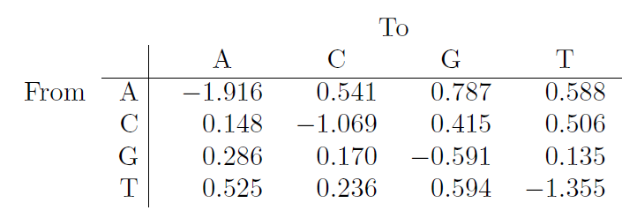
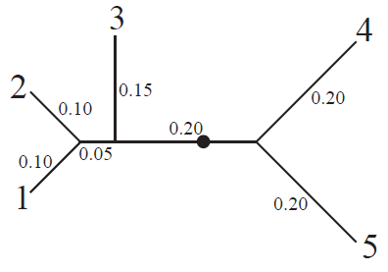
Maximum Likelihood Estimation Data (Given)
3. Substitution Rate Matrix (Given)
Denoted by Q
Q_{AC} means substitution rate of A to C = 0.541 (From Q Matrix)
(EXTRA) Probability ( A -> C ) = ( Q_{AC} ) / ( Q_{AC} + Q_{AG} + Q_{AT} ) = 0.541 / ( 0.541 + 0.787 + 0.588 )
= 0.541 / 1.916
= 0.282
1. Tree Topology with Branch Lengths (Given)
2. Stationary Probabilities (Given)
π_{a} = 0.138
π_{c} = 0.188
π_{g} = 0.495
π_{t} = 0.179

Slide 5
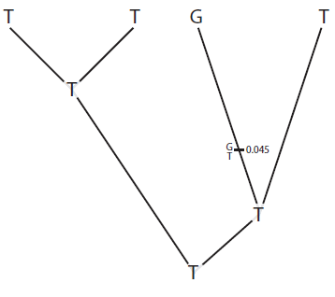
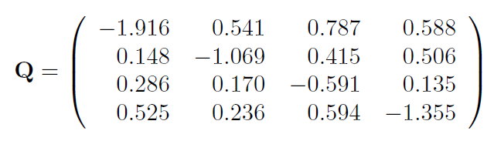
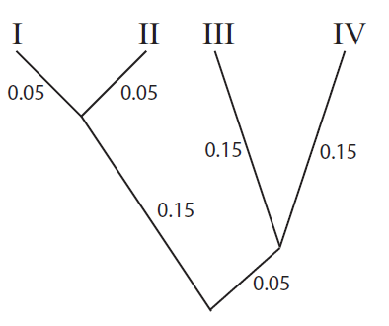


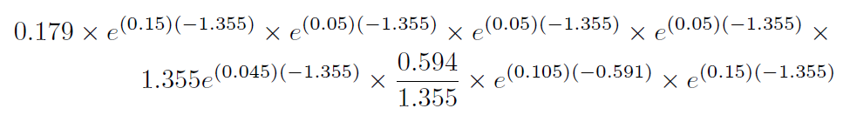

Maximum Likelihood Estimation Data (Example)
History (Given)
π_{A} = 0.138, π_{C} = 0.188, π_{G} = 0.495, π_{T} = 0.179
Maximum Likelihood
=
Branch Length (Given)

Slide 6
Maximum Likelihood Estimation Data (Example Explained)
π_{T} for Root’s Stationary Probability
For each branch which has same start and end point, multiply e (branch length) x Q (start alphabet, end alphabet)
For one branch (as you can see, the 3rd branch) there is a transition in history. Started from T, then transitioned from T to G then finally G to G from that transition point
For this kind of branch, you have to multiply and extra (-Q_{TT}) for the T-T transition from initial point to transition point and another extra (-Q_{TG}/Q_{TT}) ratio as it changing from T to G for the G-G transition
Maximum Likelihood
=
Up to T-G transition point in 3rd branch, the T-T branch length is 0.045
Total branch length is 0.15
So G-G branch length will be (0.15-0.045) = 0.105

Slide 7
Final-Done
TO BE CONTINUED

